Slide 1
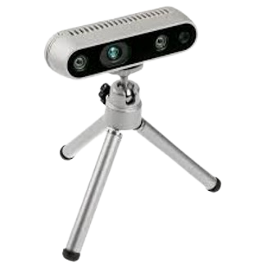
REAL-TIME OBJECT DETECTION AND DISTANCE TRACKING using INTEL REALSENSE CAMERA
Submitted by: Aryan Karkra 2K20/IT/31 Raavi Singh 2K20/IT/111

Slide 2
contents
Intel REALSENSE Camera
Distance Tracking
R-CNN
Object DETECTION
Libraries Used
Future Work

Slide 3
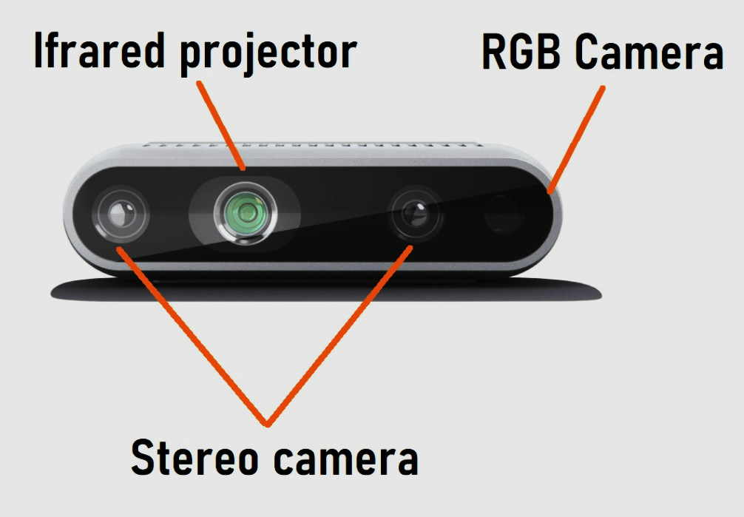
Intel REALSENSE camera
The intel real sense d435i is a 3D camera system that uses a combination of RGB and infrared sensors to capture depth information and provide accurate and high-quality 3D images.
It is designed for a wide range of applications, including robotics, autonomous vehicles, augmented and virtual reality, 3D scanning, and more.
The d435i is an improved version of the d435, which includes an integrated inertial measurement unit (imu) for improved motion tracking and orientation sensing.

Slide 4
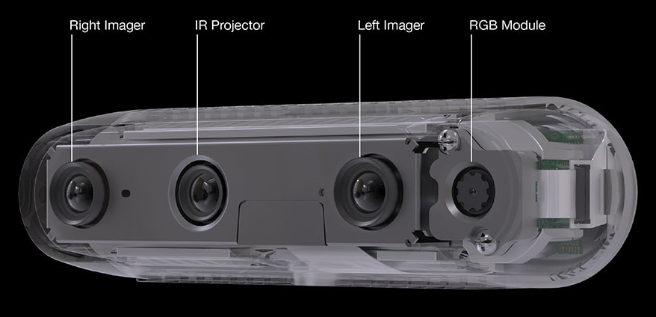
The d435i has a range of up to 10 meters and can capture high-quality 3D images at up to 90 frames per second.
One of the unique features of the d435i is its ability to track objects in real-time.
The camera can detect and track multiple objects simultaneously, allowing it to be used for applications such as robotics and autonomous vehicles.
The d435i is compatible with a wide range of platforms, including windows, Linux, and macOS.

Slide 5
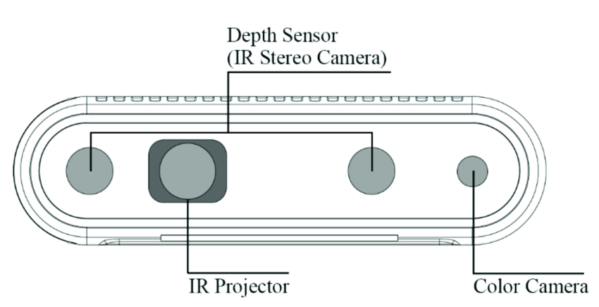
Distance tracking
Distance detection using the intel realsense2 camera is done by capturing a depth map of the scene, which is essentially a 2D representation of the 3D environment.
The depth map is obtained by projecting an infrared pattern onto the scene and measuring the time it takes for the pattern to bounce back to the camera.

Slide 6
This information is then used to calculate the distance of each pixel in the image, which can be used to create a 3D point cloud of the scene.
The accuracy of the depth map depends on several factors such as lighting conditions, texture of the objects, and the distance from the camera.
The intel realsense d435i is a 3d camera system that uses a combination of rgb and infrared sensors to capture depth information and provide accurate and high-quality 3d images.
The distance can be calculated by taking the average depth of the object pixels within the bounding box provided by the object detection model.

Slide 7
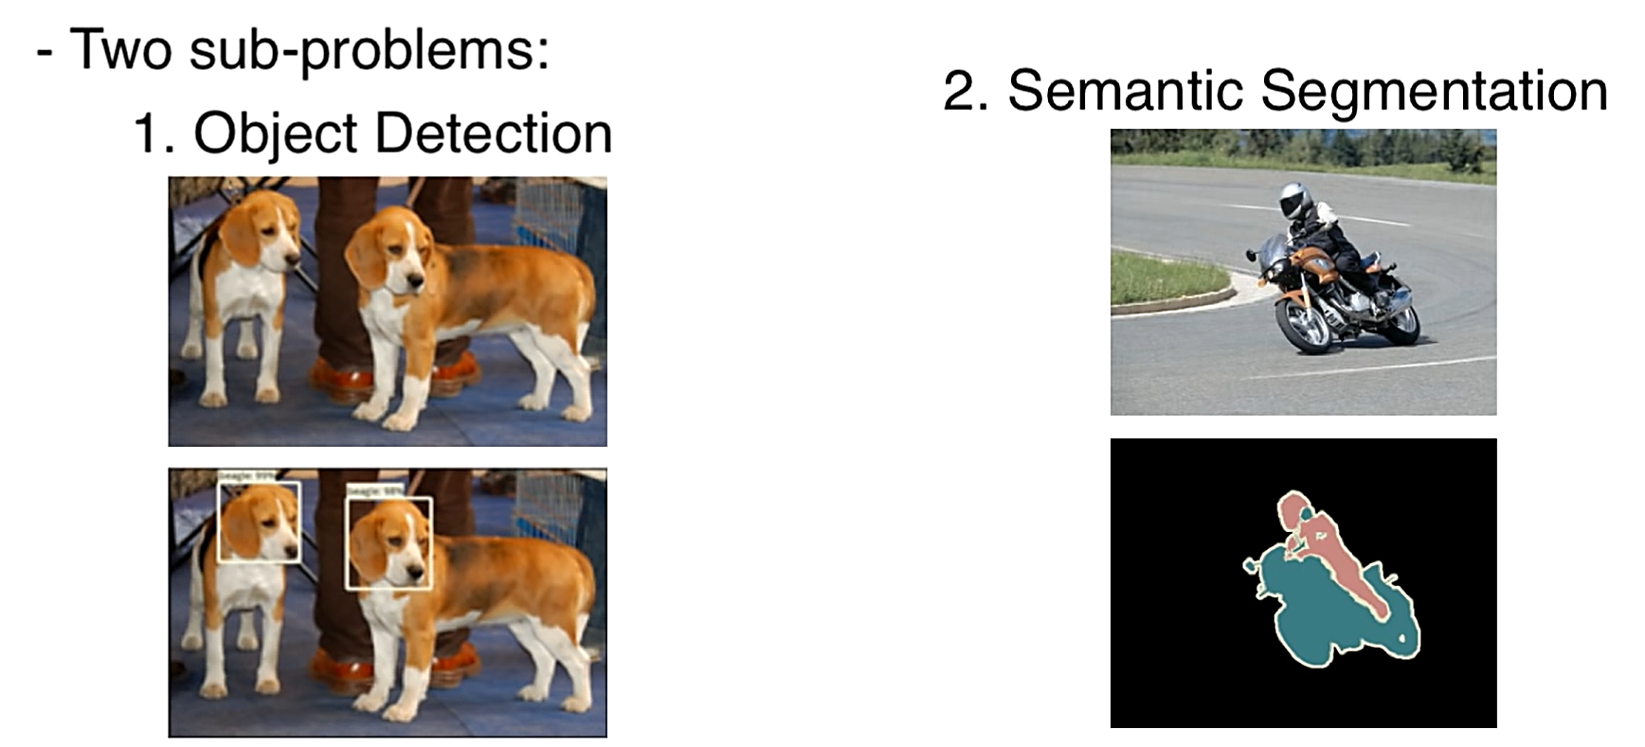
MASK RCNN
Mask R-CNN is a deep learning algorithm for object detection and segmentation.
It is an extension of the Faster R-CNN algorithm, which adds a branch for predicting object masks in parallel with the existing branch for bounding box recognition.

Slide 8
OBJECT DETECTION - RCNN
R-CNN (region-based convolutional neural network) is a deep learning algorithm for object detection.
It works by first generating a set of object proposals using a selective search algorithm.
Each proposal is then passed through a convolutional neural network (CNN) to extract a feature vector.
The feature vector is then fed into a set of class-specific linear SVMs (support vector machines) to classify the object and refine its bounding box.
R-CNN achieves state-of-the-art results on several benchmark datasets, including pascal voc and MS Coco.

Slide 9
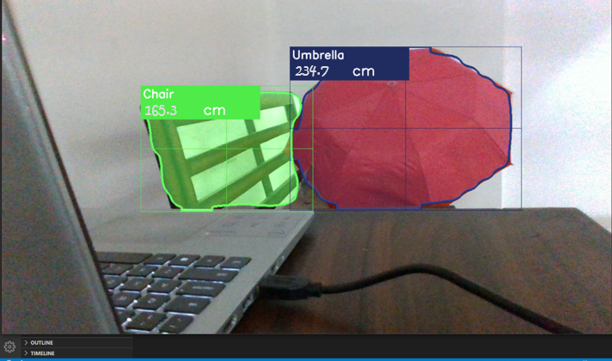
Deep learning algorithms, such as convolutional neural networks (CNNs), have revolutionized object recognition by automatically learning features from raw data and achieving state-of-the-art results on several benchmark datasets.
CNNs work by first convolving the input image with a set of learnable filters to extract features at different spatial scales.
The features are then passed through a series of nonlinear activation functions and pooling layers to reduce their dimensionality and increase their invariance to translation and rotation.

Slide 10
LIBRARIES USED
OpenCV: OpenCV is used for object recognition and distance measurement from the depth camera.
Pyrealsense2 python wrapper for the intel realsense SDK 2.0, which is used for working with intel's realsense depth cameras. Pyrealsense2 is used for accessing the depth data from the intel realsense depth camera.
Numpy numpy is used for various array operations related to image processing, such as array slicing, concatenation, and arithmetic operations.

Slide 11
FUTURE WORK
To incorporate additional sensors or camera modules to provide a more comprehensive view of the environment.
For example, integrating a lidar sensor could help to provide more accurate depth information, while a thermal camera could help to detect objects that are not easily visible in the visible spectrum.
Can be integrated with security cameras
Increase accuracy and tracking distance

Slide 12
THANK YOU

